Slide 1

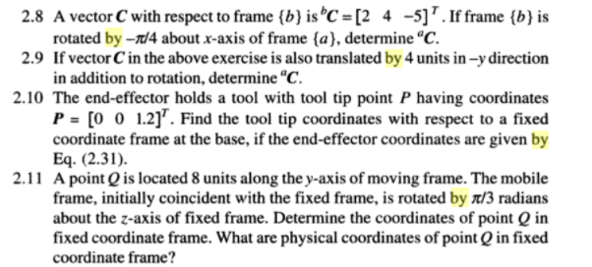
Solve the above sums.

Slide 2

P
When the helicopter was on the ground (on frame 1), the point P was
having coordinates(0,0,10). Later the helicopter rose to a height of
1000 units and tilted about Z axis by 20 degrees. Determine the
New coordinates of point P. Also determine homogeneous transformation
matrix of frame 2 with respect to frame 1.
w
v
u
Z
{1}
Y
X

